Slide 1
Company Name
Company Profile - just 1 or 2 sentences to tell the audience what kind of company you are.
I.e. - J Labs is a mobile app developer making it easy for people to find dog sitters.
Introduce yourselves so the audience knows who is addressing them. This is NOT where you provide your team info, that comes later. Avoid using lofty titles such as CEO etc. Best to say you’re a founder/co-founder.

Slide 2
The Problem
Describe the problem that your target customers experience
What are the pain points for the customer?
Why is this problem important? Why is it urgent?
How does it impact your customer?
Reference what you learned via customer discovery - use the words of your customers
This slide sets the stage for many others. Do this right and the others become easier, more relevant, and you’ll deliver a better narrative.

Slide 3
The Solution
Brief description of the product or service that you are proposing that will solve the problem.
This is not an explanation of your technology, there is a later slide for that.
A picture of the product or someone using the service would be appropriate here.

Slide 4
Your Product / Service
Describe your product in terms of
The functionality it provides and key benefits
Its design and physical configuration
Your key “value add”
Visuals are important! Screen shots, diagrams, 3D renderings
What is the status of your product?
Examples: Idea, Demo, Prototype, In Market
*Product = goods or services

Slide 5
The Customer
Describe the customer(s), that have the problem that you described
You may describe multiple types, stakeholders, and other decision makers & influencers
Create personas, use images, combine with highly specific demographic and behavioral information
The intent is to demonstrate that you know how to target these customers in your marketing

Slide 6
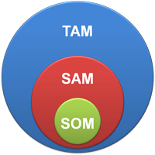
TAM/SAM/SOM
On the previous slide you told us WHO your customer is. Now tell us how many there are.
Where are they? Are the numbers growing, declining?
TAM or Total Available Market -total market demand for a product or service.
SAM or Serviceable Available Market - the segment of the TAM targeted by your products and services.
SOM or Serviceable Obtainable Market - the portion of SAM that you can capture.
Generally displayed in chart form

Slide 7
Value Proposition
Why does your customer care?
How is your product / service differentiated?
What is the quantified benefit?
Value Proposition Statement
For ____________________________________________________________(target customer)
who need _________________________________________________(statement of the need)
our ______________________________________________________(product/service name)
will provide _________________________________________________(statement of benefit)
unlike the competition ___________________
our _______________________________________________________(product/service name)
reason to believe ___________________________________________(better, faster, cheaper)

Slide 8
Competitive Situation
Describe the competitive situation surrounding your product
NOTE that while you may or may not have competitors that are doing exactly what you’re doing, there are likely to be offerings aimed at the same value proposition. Also, the customer is dealing with his/her problem in some way today. These both represent forms of competition.
Important! Relate your points of difference to the statements in your problem slide.
A matrix or quadrant graphic is best - aim for a quick visual impression that shows clear differentiation.

Slide 9
Business Model
Describe how you function as a company - do this graphically
Describe your supply chain
Are you manufacturing yourself or outsourcing?
Who are your key materials & parts suppliers?
How do you fulfill customer orders?
Where do you add value? Where do others add value?
What are your important revenue streams?
What are your sales channels?
How is your business model unique?

Slide 10
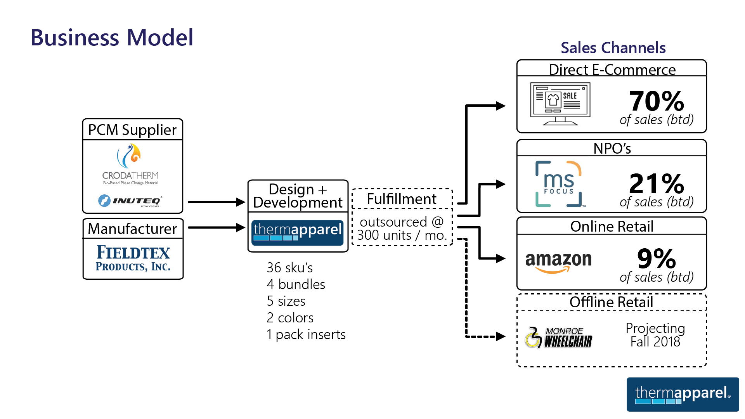
Example Business Model
13

Slide 11
Marketing/Sales Plan
Marketing: Describe how you will create awareness and generate leads
What specific tactics and marketing channels will you use?
What’s your CAC and LTV?
What’s your 1st year marketing budget?
Sales: Describe how you will sell. Direct? Distributors? Retail?
What will you do to support your sales channels?

Slide 12
Financial Projections
Use the template provided on myCourses
Show only yearly totals. Fill this entire slide with the data - no need for a title
What critical assumptions drive your financial results?

Slide 13
Management Team
List the members of your management team
What relevant experience do they have that will foster success?
Discuss relevant education, experience, skills
Who is on your Board of Advisors?
Discuss gaps and needs on your team

Slide 14
Customer Discovery &
Learning Plan
How many customer discovery interviews were completed?
How did your CD impact or change your original plan?
What are the important 3 – 4 assumptions from your Customer Discovery Report that are unresolved?
List them and identify on the list, who will resolve, how will they resolve and when.

Slide 15
The “Ask”
For this class, your ask is for resources that will help advance your business
Expertise
Staff
Advisors
Labs, equipment
Materials
If you ask for funding, state…
For what will the funds be used?
What are the timeframes and milestones?
What outcomes will be achieved?

